Slide 1
Database Systems:
Design, Implementation, and Management
Ninth Edition
Chapter 3
The Relational Database Model

Slide 2
Objectives
In this chapter, students will learn:
  That the relational database model offers a logical view of data
  About the relational model’s basic component: relations
  That relations are logical constructs composed of rows (tuples) and columns (attributes)
  That relations are implemented as tables in a relational DBMS
Database Systems, 9th Edition

Slide 3
Objectives (cont’d.)
  About relational database operators, the data dictionary, and the system catalog
  How data redundancy is handled in the relational database model
  Why indexing is important
Database Systems, 9th Edition

Slide 4
A Logical View of Data
Relational model
  View data logically rather than physically
Table
  Structural and data independence
  Resembles a file conceptually
Relational database model is easier to understand than hierarchical and network models
Database Systems, 9th Edition

Slide 5
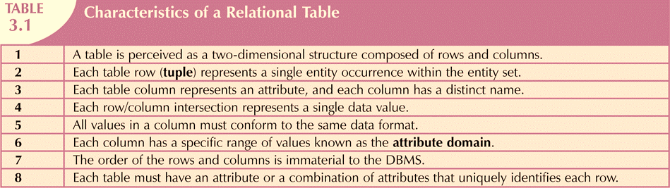
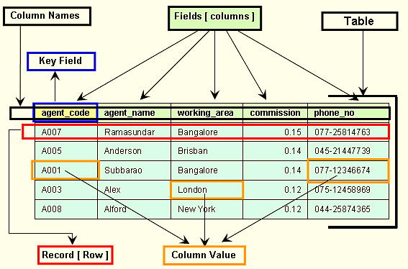
What is the Table?
Database Systems, 9th Edition

Slide 6
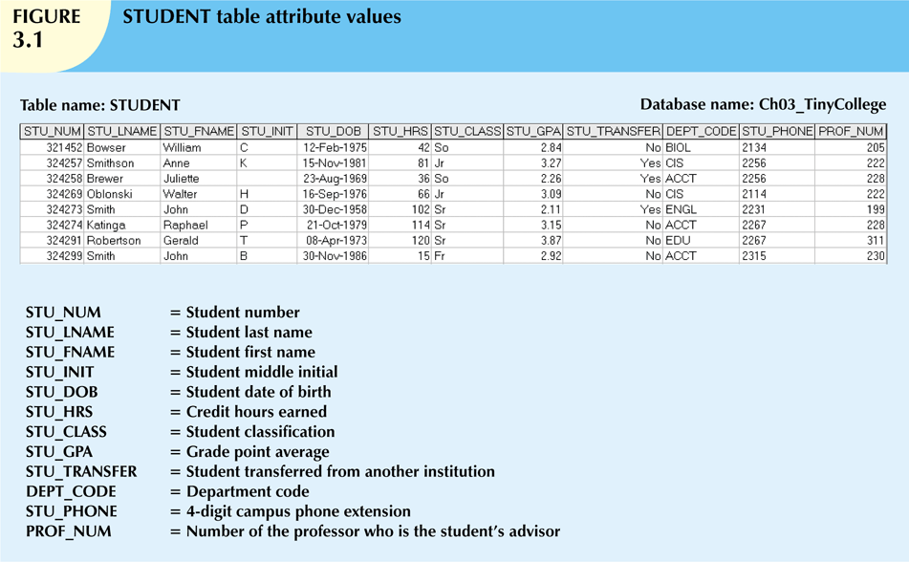

Slide 7
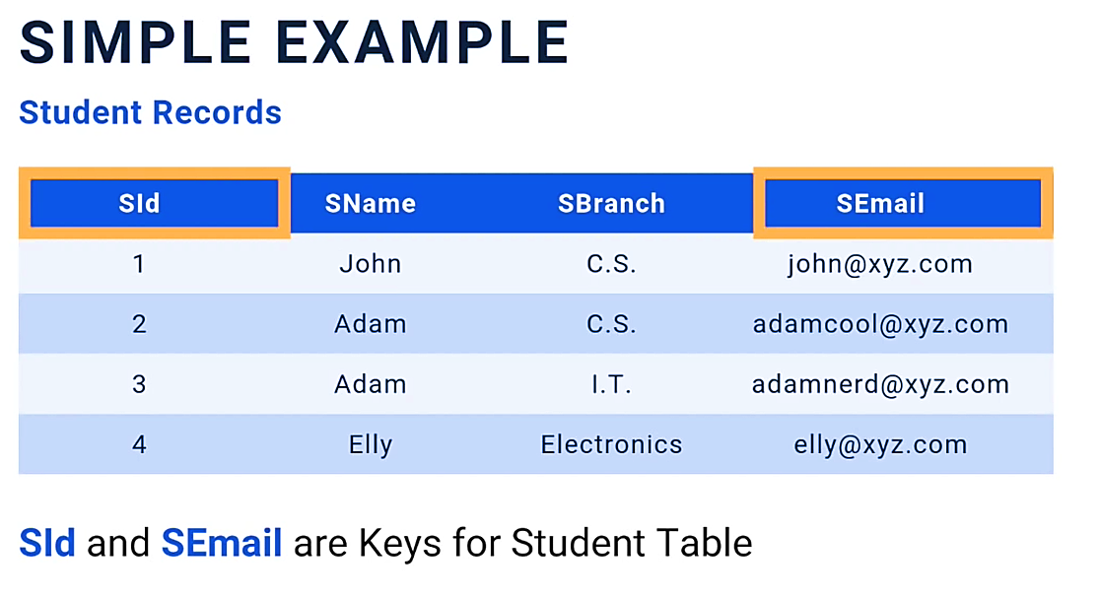
Database Systems, 9th Edition

Slide 8
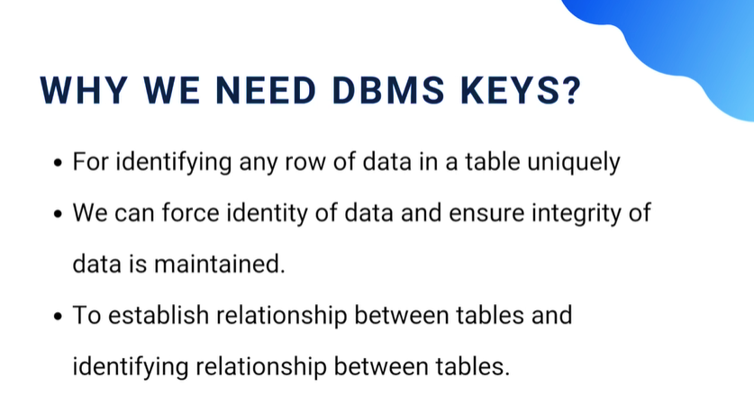
Database Systems, 9th Edition

Slide 9
Keys
Each row in a table must be uniquely identifiable
Key is one or more attributes that determine other attributes
Key’s role is based on determination
  If you know the value of attribute A, you can determine the value of attribute B
Functional dependence
  Attribute B is functionally dependent on A if all rows in table that agree in value for A also agree in value for B
Database Systems, 9th Edition

Slide 10
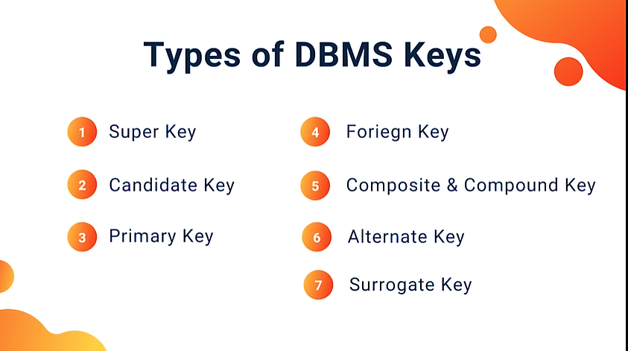
Database Systems, 9th Edition

Slide 12
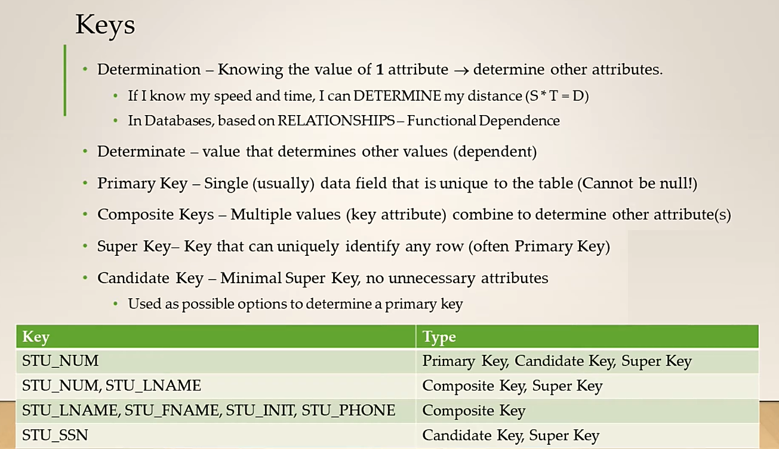
Database Systems, 9th Edition

Slide 13
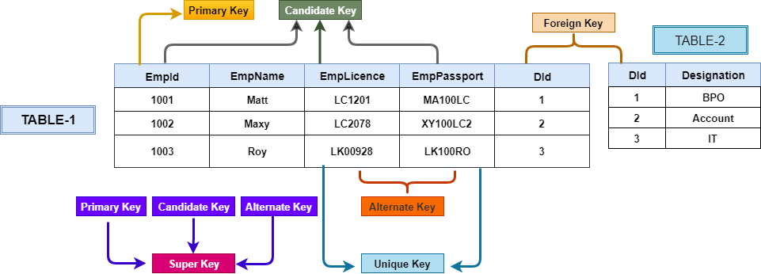
Database Systems, 9th Edition

Slide 14
Keys (cont’d.)
Nulls
  No data entry
  Not permitted in primary key
  Should be avoided in other attributes
  Can represent:
    An unknown attribute value
    A known, but missing, attribute value
    A “not applicable” condition
Database Systems, 9th Edition

Slide 15
Keys (cont’d.)
Nulls (cont’d.)
  Can create problems when functions such as COUNT, AVERAGE, and SUM are used
  Can create logical problems when relational tables are linked
Database Systems, 9th Edition

Slide 16
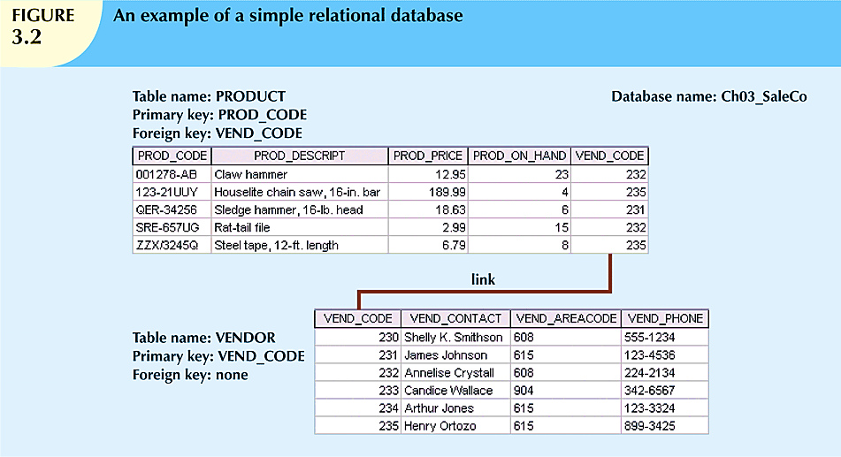
Database Systems, 9th Edition

Slide 17
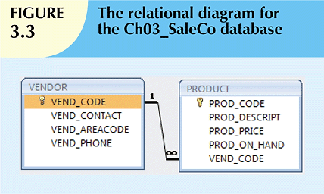
Database Systems, 9th Edition

Slide 18
Keys (cont’d.)
Foreign key (FK)
  An attribute whose values match primary key values in the related table
Referential integrity
  FK contains a value that refers to an existing valid tuple (row) in another relation
Secondary key
  Key used strictly for data retrieval purposes
Database Systems, 9th Edition

Slide 19
Integrity Rules
Many RDBMs enforce integrity rules automatically
Safer to ensure that application design conforms to entity and referential integrity rules
Designers use flags to avoid nulls
  Flags indicate absence of some value
Database Systems, 9th Edition
Notes:
To make sure our ERD is correct

Slide 20
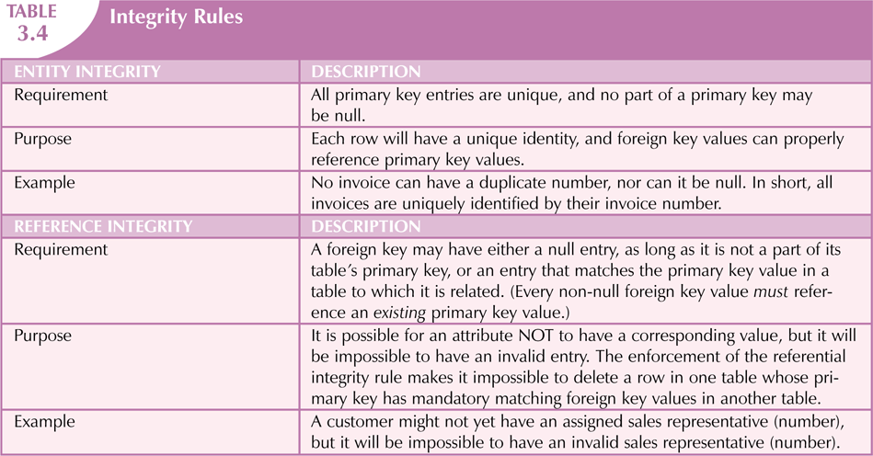

Database Systems, 9th Edition

Slide 21
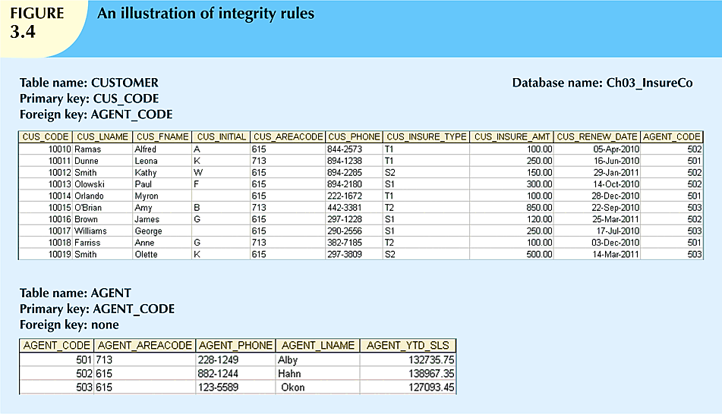
Database Systems, 9th Edition

Slide 22
Relational Set Operators
Relational algebra
  Defines theoretical way of manipulating table contents using relational operators
  Use of relational algebra operators on existing relations produces new relations:
SELECT | DIFFERENCE
PROJECT | JOIN
UNION | PRODUCT
INTERSECT | DIVIDE
Database Systems, 9th Edition

Slide 23
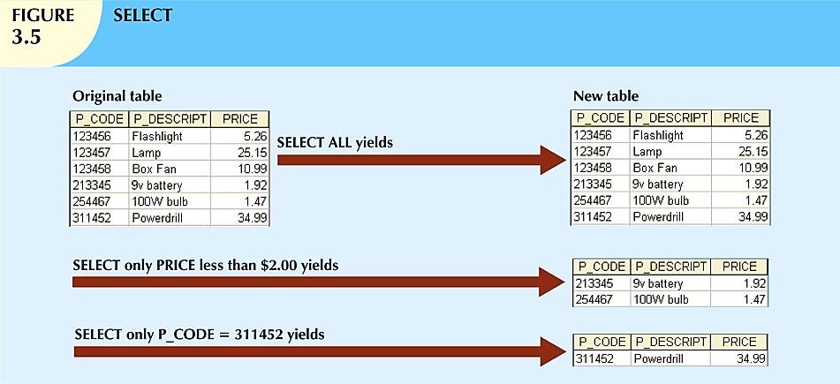
Database Systems, 9th Edition

Slide 24
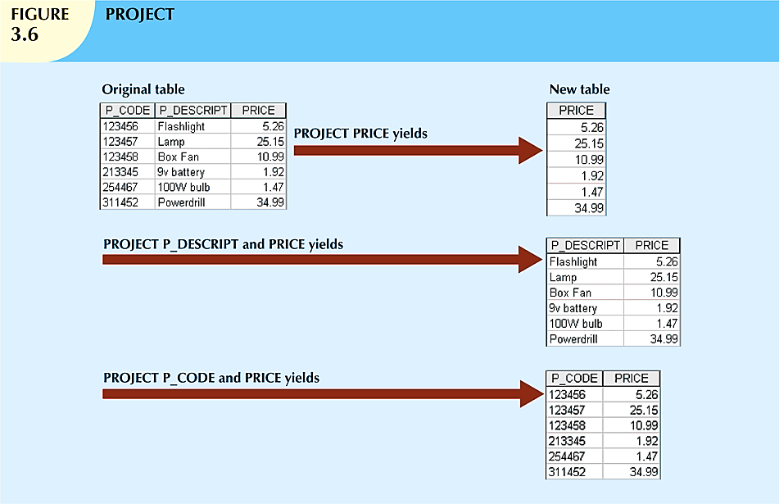
Database Systems, 9th Edition

Slide 25
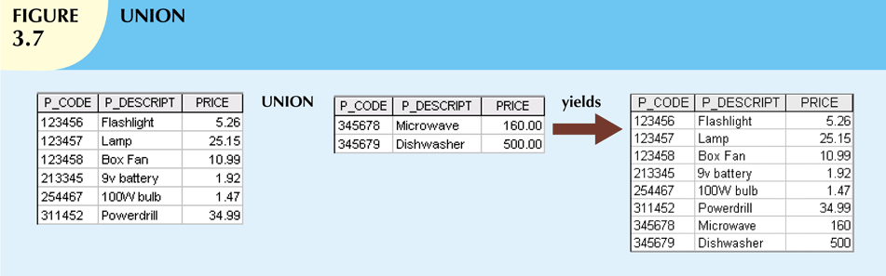
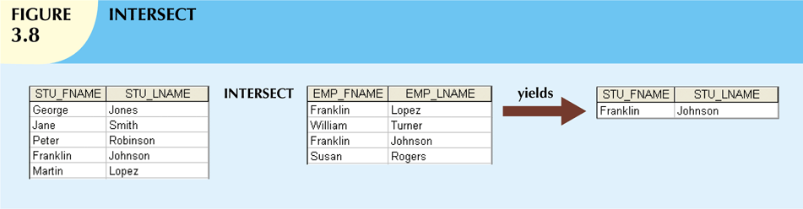
Database Systems, 9th Edition

Slide 26
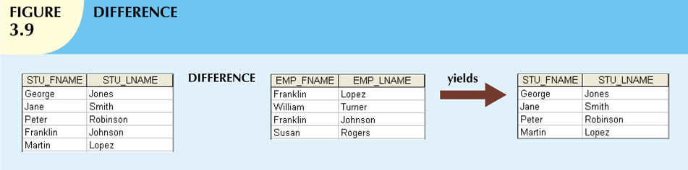
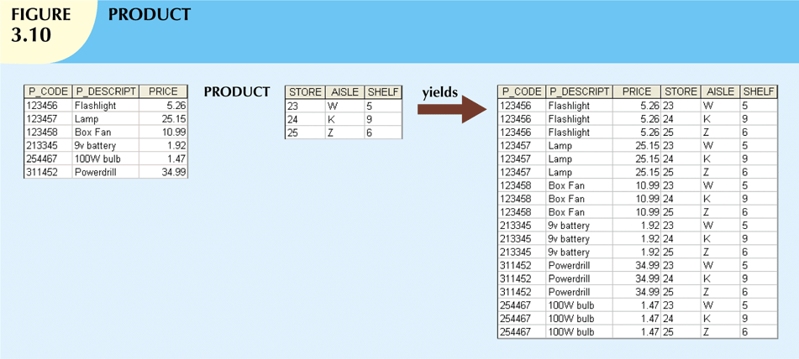
Database Systems, 9th Edition

Slide 27
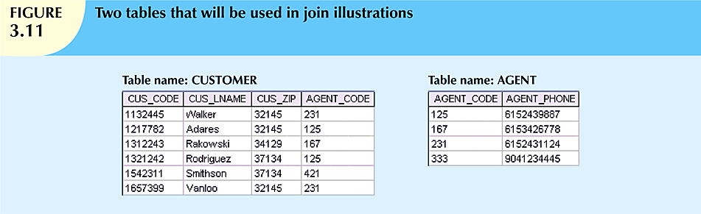
Database Systems, 9th Edition

Slide 28
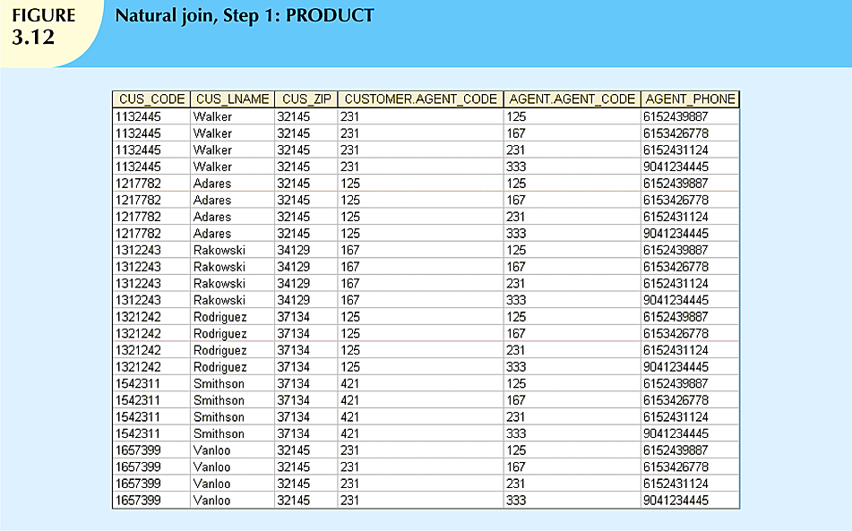
Database Systems, 9th Edition

Slide 29
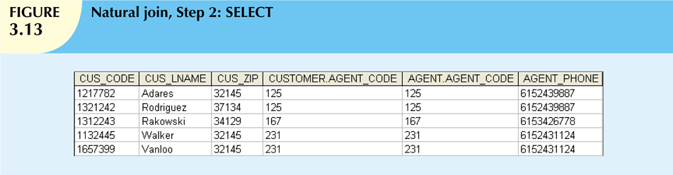
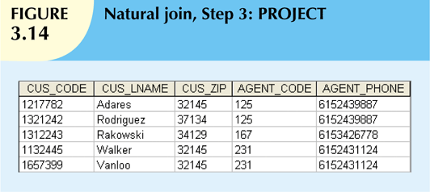
Database Systems, 9th Edition

Slide 30
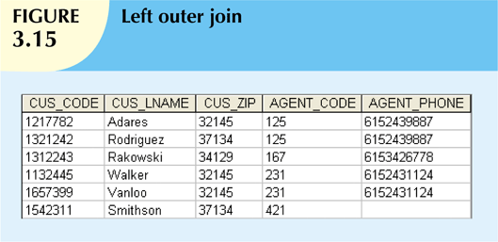
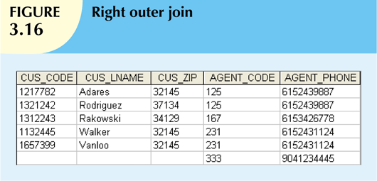
Database Systems, 9th Edition

Slide 31
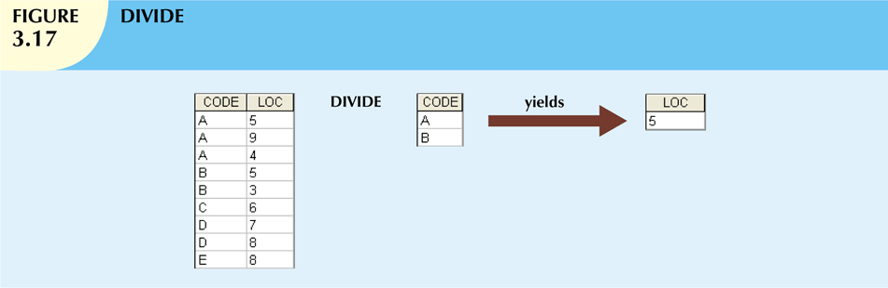
Database Systems, 9th Edition

Slide 32
Relational Set Operators (cont’d.)
Natural Join
  Links tables by selecting rows with common values in common attribute(s)
Equijoin
  Links tables on the basis of an equality condition that compares specified columns
Theta join
  Any other comparison operator is used
Outer join
  Matched pairs are retained, and any unmatched values in other table are left null
Database Systems, 9th Edition

Slide 33
The Data Dictionary and System Catalog
Data dictionary
  Provides detailed accounting of all tables found within the user/designer-created database
  Contains (at least) all the attribute names and characteristics for each table in the system
  Contains metadata: data about data
System catalog
  Contains metadata
  Detailed system data dictionary that describes all objects within the database
Database Systems, 9th Edition

Slide 34
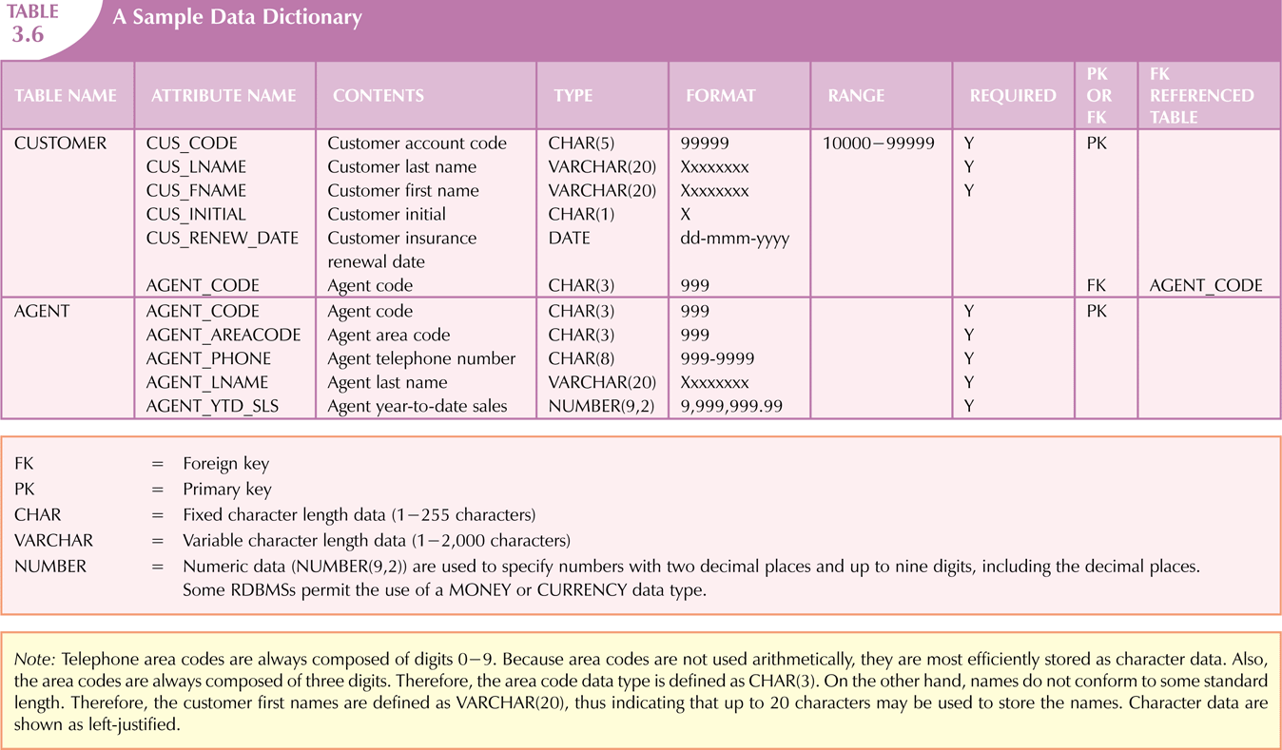
Database Systems, 9th Edition

Slide 35
Relationships within the Relational Database
1:M relationship
  Relational modeling ideal
  Should be the norm in any relational database design
1:1 relationship
  Should be rare in any relational database design
Database Systems, 9th Edition

Slide 36
Relationships within the Relational Database (cont’d.)
M:N relationships
  Cannot be implemented as such in the relational model
  M:N relationships can be changed into 1:M relationships
Database Systems, 9th Edition

Slide 37
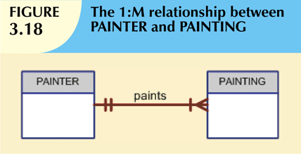
The 1:M Relationship
Relational database norm
Found in any database environment
Database Systems, 9th Edition

Slide 38
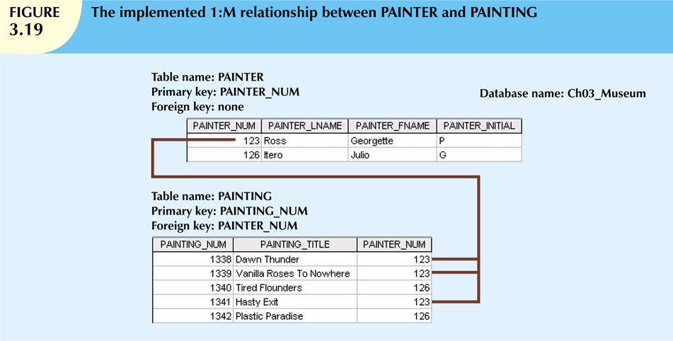
Database Systems, 9th Edition

Slide 39
The 1:1 Relationship
One entity related to only one other entity, and vice versa
Sometimes means that entity components were not defined properly
Could indicate that two entities actually belong in the same table
Certain conditions absolutely require their use
Database Systems, 9th Edition

Slide 40
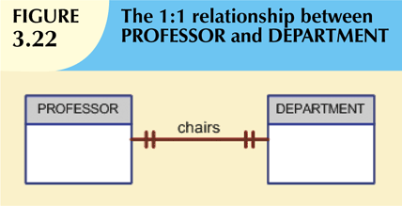
Database Systems, 9th Edition

Slide 41
The M:N Relationship
Implemented by breaking it up to produce a set of 1:M relationships
Avoid problems inherent to M:N relationship by creating a composite entity
  Includes as foreign keys the primary keys of tables to be linked
Database Systems, 9th Edition

Slide 42
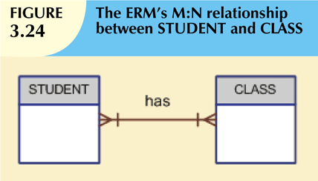
Database Systems, 9th Edition

Slide 43
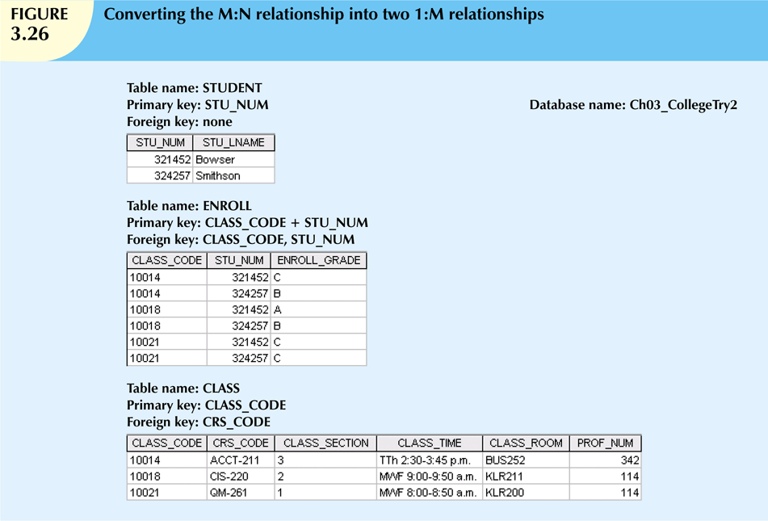
Database Systems, 9th Edition

Slide 44
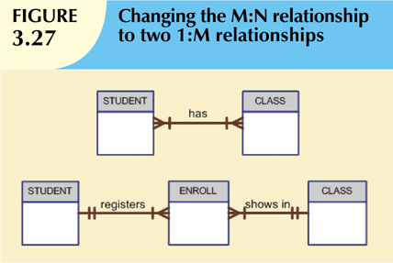
Database Systems, 9th Edition

Slide 45
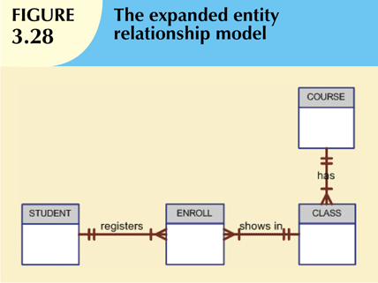
Database Systems, 9th Edition

Slide 46
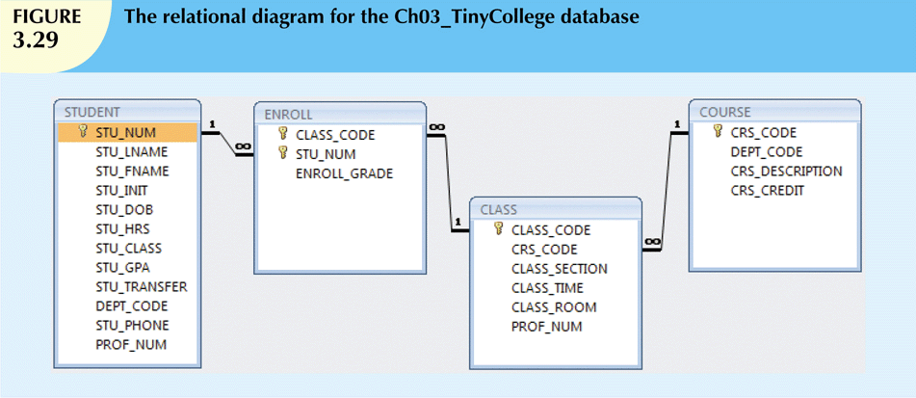
Database Systems, 9th Edition

Slide 47
Data Redundancy Revisited
Data redundancy leads to data anomalies
  Can destroy the effectiveness of the database
Foreign keys
  Control data redundancies by using common attributes shared by tables
  Crucial to exercising data redundancy control
Sometimes, data redundancy is necessary
Database Systems, 9th Edition

Slide 48
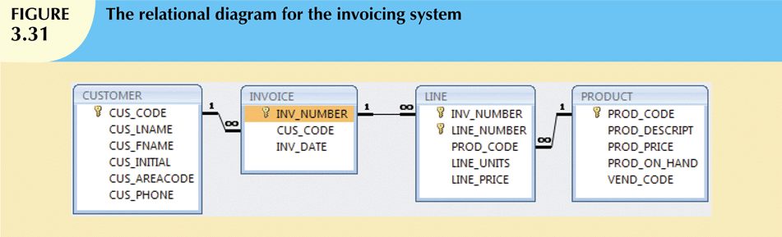
Database Systems, 9th Edition

Slide 49
Indexes
Orderly arrangement to logically access rows in a table
Index key
  Index’s reference point
  Points to data location identified by the key
Unique index
  Index in which the index key can have only one pointer value (row) associated with it
Each index is associated with only one table
Database Systems, 9th Edition

Slide 50
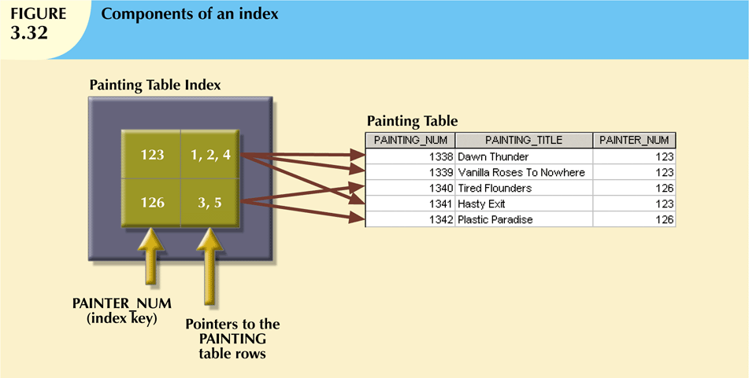
Database Systems, 9th Edition

Slide 51
Codd’s Relational Database Rules
In 1985, Codd published a list of 12 rules to define a relational database system
  Products marketed as “relational” that did not meet minimum relational standards
Even dominant database vendors do not fully support all 12 rules
Database Systems, 9th Edition

Slide 52
Summary
Tables are basic building blocks of a relational database
Keys are central to the use of relational tables
Keys define functional dependencies
  Superkey
  Candidate key
  Primary key
  Secondary key
  Foreign key
Database Systems, 9th Edition

Slide 53
Summary (cont’d.)
Each table row must have a primary key that uniquely identifies all attributes
Tables are linked by common attributes
The relational model supports relational algebra functions
  SELECT, PROJECT, JOIN, INTERSECT UNION, DIFFERENCE, PRODUCT, DIVIDE
Good design begins by identifying entities, attributes, and relationships
  1:1, 1:M, M:N
Database Systems, 9th Edition

